Slide 1
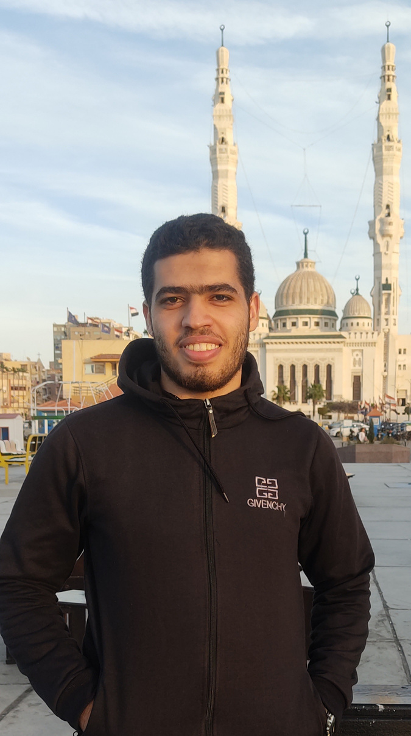
Eng-Mohamed Ayman .
Machine Learning Engineer .
Now you are going on a jour ney to my small career in the field of
“ MACHINE LEARNING ” . I wish you a pleasant jour ney .

Slide 2
Oh , Hello There !
ABOUT ME
I’m a machine learning engineer with a passion for developing innovative solutions to complex problems.With a background in computer science and hands-on not much experience in machine learning , I specialize in designing and implementing algorithms to extract insights from data. My goal is to leverage machine learning to drive impactful results across various industries.

Slide 3
Skills :
Python, Data Preprocessing, Model Deployment, NLP .
Projects :
To See My Projects Click On My Accounts
GitHub Account : Mohamed-290
Kaggle Account : mohamedaymanhassan
1. Predictive Maintenance System To House Prices:
Description: Developed a predictive maintenance model to forecast equipment failures in a manufacturing plant.
Technologies: Python, Numpy, Pandas, Matplotlib,
Linear Regression Model and Other Models .

Slide 4
Problem Statement :
There are a lot of Problems in data such as Error data, Missing Values, Duplicates and more Problems .
Solution :
You Clean The Data :
1- Missing Values .
2- Duplicates .
3- Frequence .
4- Scaling .
5- Outliers .
6- Irrelevent Data.
7- Encoding .
8- Splitling data to train and test data .

Slide 5
Results: Achieved at the least 90% accuracy rate .
Code & Demo :
Link_GitHUb_House_prices_Project
2. Predictive Maintenance System To Social_Network
_Ads :
Description: Developed a predictive maintenance model to forecast equipment failures in a manufacturing plant.
Technologies: Python, Numpy, Pandas, Matplotlib,
Linear Regression Model and Other Models .

Slide 6
Problem Statement:
There are a lot of Problems in data such as Error data, Missing Values, Duplicates and more Problems .
Solution:
You work Analysis and Preprossing To Data :
1- Missing Values .
2- Duplicates .
3- Frequence .
4- Scaling .
5- Outliers .
6- Irrelevent Data.
7- Encoding .
8- Splitling data to train and test data .

Slide 7
Results: Achieved at the least 80% accuracy rate .
Code & Demo:
Link_GitHub_Social_Network_Ads_Project
Track Steps :
✅ Python programming from A to Z .
✅ Machine Learning : (Supervised & Unsupervised ):
🔶 Supervised :
1- Modeling Regression : ( Linear Regression - Ployment Regression - SVM - D.T - R.F - KNN - XGBOOST ) .
2- Classification : ( LOG. - SVM - D.T - R.F - KNN - XGBOOST ) .
🔶 Unsupervised :
1- Clustering : ( Model Training With Unlabelied Data ) .
✅ Deep Neural Networks :
🔶 ANN (Artificial neural networks) .
🔶 CNN ( Image classification ) .
🔶 RNN ( Time series data ) .

Slide 8
Tracking Tools :
1- Colab Notebooks .
2- Jupyter Notebooks .
3- GitHub .
Digital Scholarships :
1- Digital Egypt Pioneers Initiative - DEPI , In
“ Microsoft Machine Learning ’’ Program
As “ Machine Learning Engineer ”.
Under The Guidance Of The Ministry Of Communications and Information Technology - MCIT , Egypt .

Slide 9
Education :
Student at the College of Engineering, Department of “ Computers and Control Systems ” .
Contact Information Me :
I am waiting for you , get in touch with me as soon as possible .
Phone Number : +20 01096148472
Whatsapp Account : +20 01096148472
Email Address : mohamedawaad290@gmail.com Linkedin Account : Linkedin_Porfile
FaceBook Account : FaceBook_Porfile

Slide 10
THANK YOU SO MUCH!
thank you so m uch

